Slide 1
BUS MANAGEMENT SYSTEM
DATABASE MANAGEMENT PROJECT

Slide 2
TEAM MEMBERS

Slide 3
INTRODUCTION
Bus Ticket Booking Management System is a computerized system which stores and retrieves data and handles transactions related to Bus travel. This project is aimed at explaining the relevance and importance of DBMS in this system. It is projected towards enhancing the relationship between customers and Bus agencies through the use of DBMS, and thereby making it convenient for the customers to book the Bus tickets as when they require such that they can utilize this software to make reservations.

Slide 4
This software has two parts. First is the customer part and the other is the administrator part. The customer part is used as a front end and the administrator part is the back end of this system. This software utilises DBMS which allows the existing customers to access database and allow new customers to sign up for online access.
This system allows the passengers to search for Busses that are available between the two travel cities, namely the “Departure city” and the “Arrival city” for particular departure and arrival dates. The system displays all the Bus details such as Bus no and name. To book a ticket the system asks the customer to enter his details such as name, age and contact number. Then it books the Bus seat and update the Bus database and customer database.

Slide 5
The system also allows the traveler to check the status of his/her reservation and allows them to select their seat number and meal options.
This system allows the administrators to update the status of the Bus if required. The main purpose of this software is to reduce the manual errors involved in the Bus ticket reservation process and make it convenient for the customers as well as for the Bus officials, to book the seat as when they require such that they can utilize this software to make reservations.

Slide 6
INDIVIDUAL CONTRIBUTIONS

Slide 7
MODULES
1. Registration module -
In the registration module if the customer already has an account then they log in into their account or else if it is a new customer then they are asked to create a new account and to enter their details. The customer can also just log in into their account and check their Bus status and they would not be required to enter any code. The details entered by the customer is later used to automatically fill in the traveller details section if the same person is travelling this makes the process faster and more efficient with less errors.

Slide 8
2. Administrative module -
The administrative module is present to manage the back hand of this system. It allows the administrators to manage the site and update the content (like the status of a Bus) at regular intervals, the major operations included in this module are -
Create and maintain Bus schedule, fare and timings of the Bus.
View the passenger list.
Updating the Bus schedule and timings and fare.

Slide 9
3. Passenger module -
This module is meant for the customer, where by logging into their account they will be able to view this panel. The major functions included in this module are -
Book for the tickets.
Select their seat number and add meal option.

Slide 10
ENTITY RELATIONSHIP DIAGRAM

Slide 11
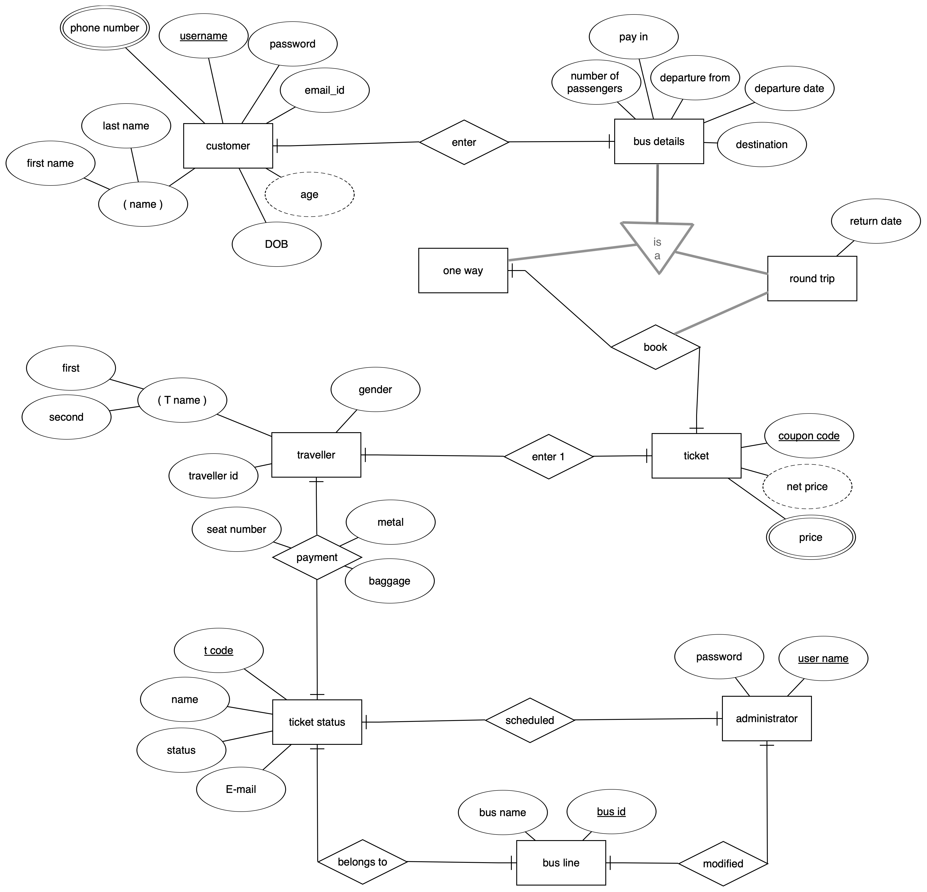

Slide 12
LANGUAGES AND TOOLS REQUIRED
PYTHON
SQLITE

Slide 13
DATABASE USED
SQLite3
Server-less architecture
Self-Contained
Needs Zero-configuration
Dynamic Datatype

Slide 14
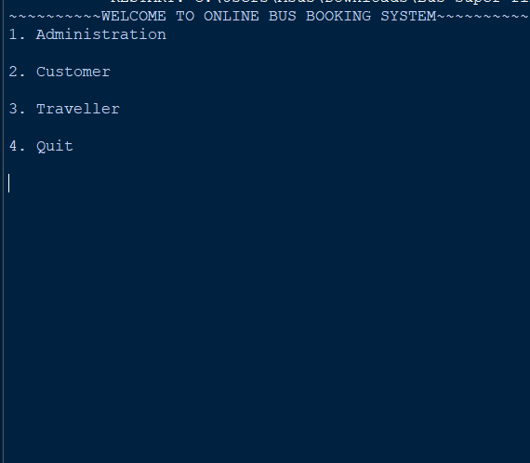
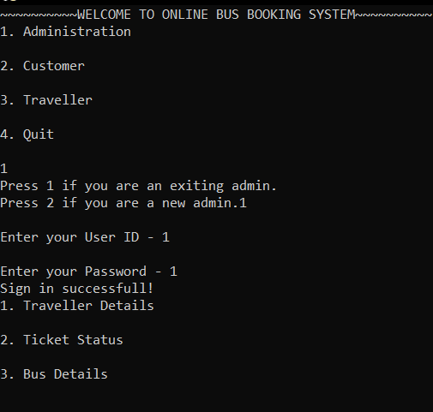
IMPLEMENTATION
Main Menu
Admin Menu

Slide 15
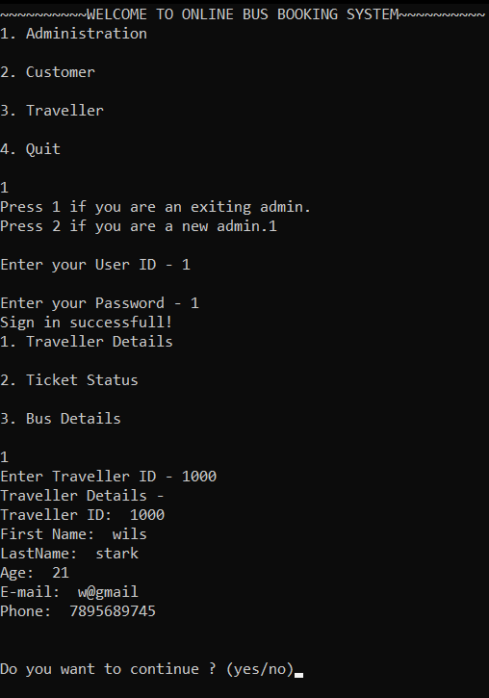
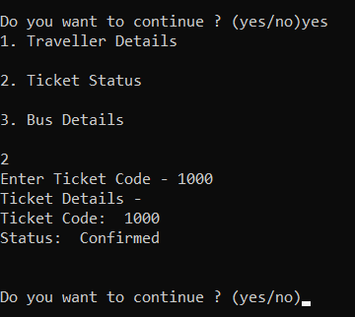
IMPLEMENTATION
Traveler details from admin menu
Ticket Status from admin menu

Slide 16
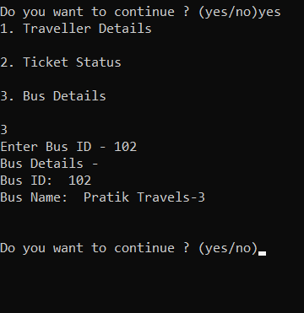
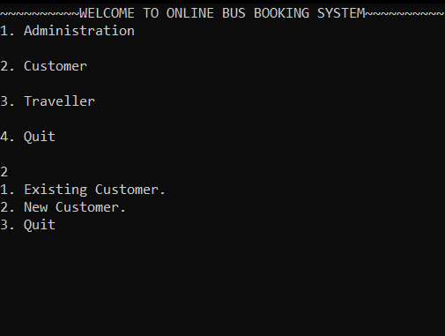
IMPLEMENTATION
Bus Details from admin menu
Customer menu

Slide 17
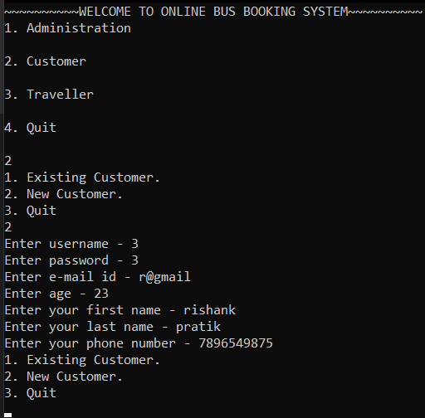
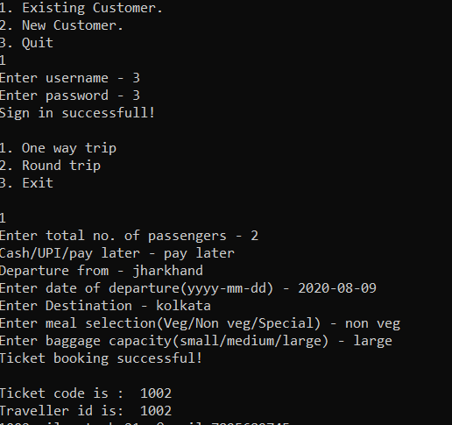
IMPLEMENTATION
New Customer Sign up
Ticket Booking

Slide 18
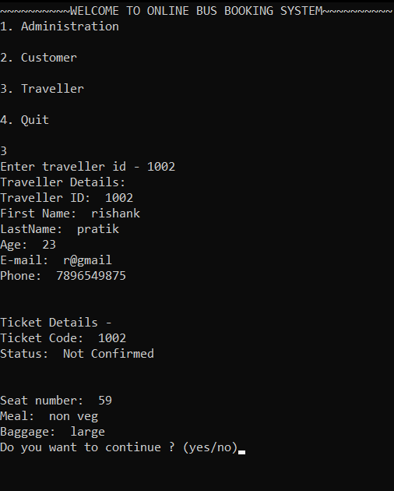
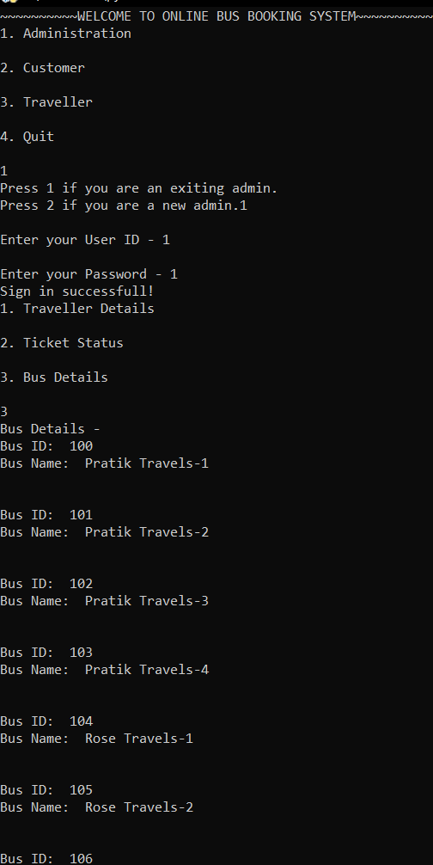
IMPLEMENTATION
Traveler Details
Bus Details

Slide 19
RESULTS AND DISCUSSIONS
The main purpose of this system is to enable user to reserve or buy ticket online through the internet. This system is not mend to manage the bus or the driver. The only concern of the system is that user can get their ticket without queuing at the ticket counter
It also implements the concurrent control method in order to ensure no data redundancy. Therefore a server is needed to store the data base and also a secure room to place the server. As a result, this system cost them quite a big money in order to ensure that it give a real satisfaction to the customers.

Slide 20
THANK YOU

